Slide 1
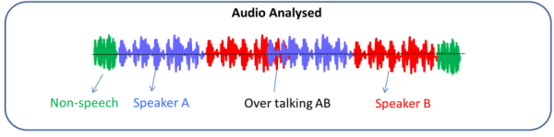
Real-time Speaker Diarization System
Henry Pan

Slide 2

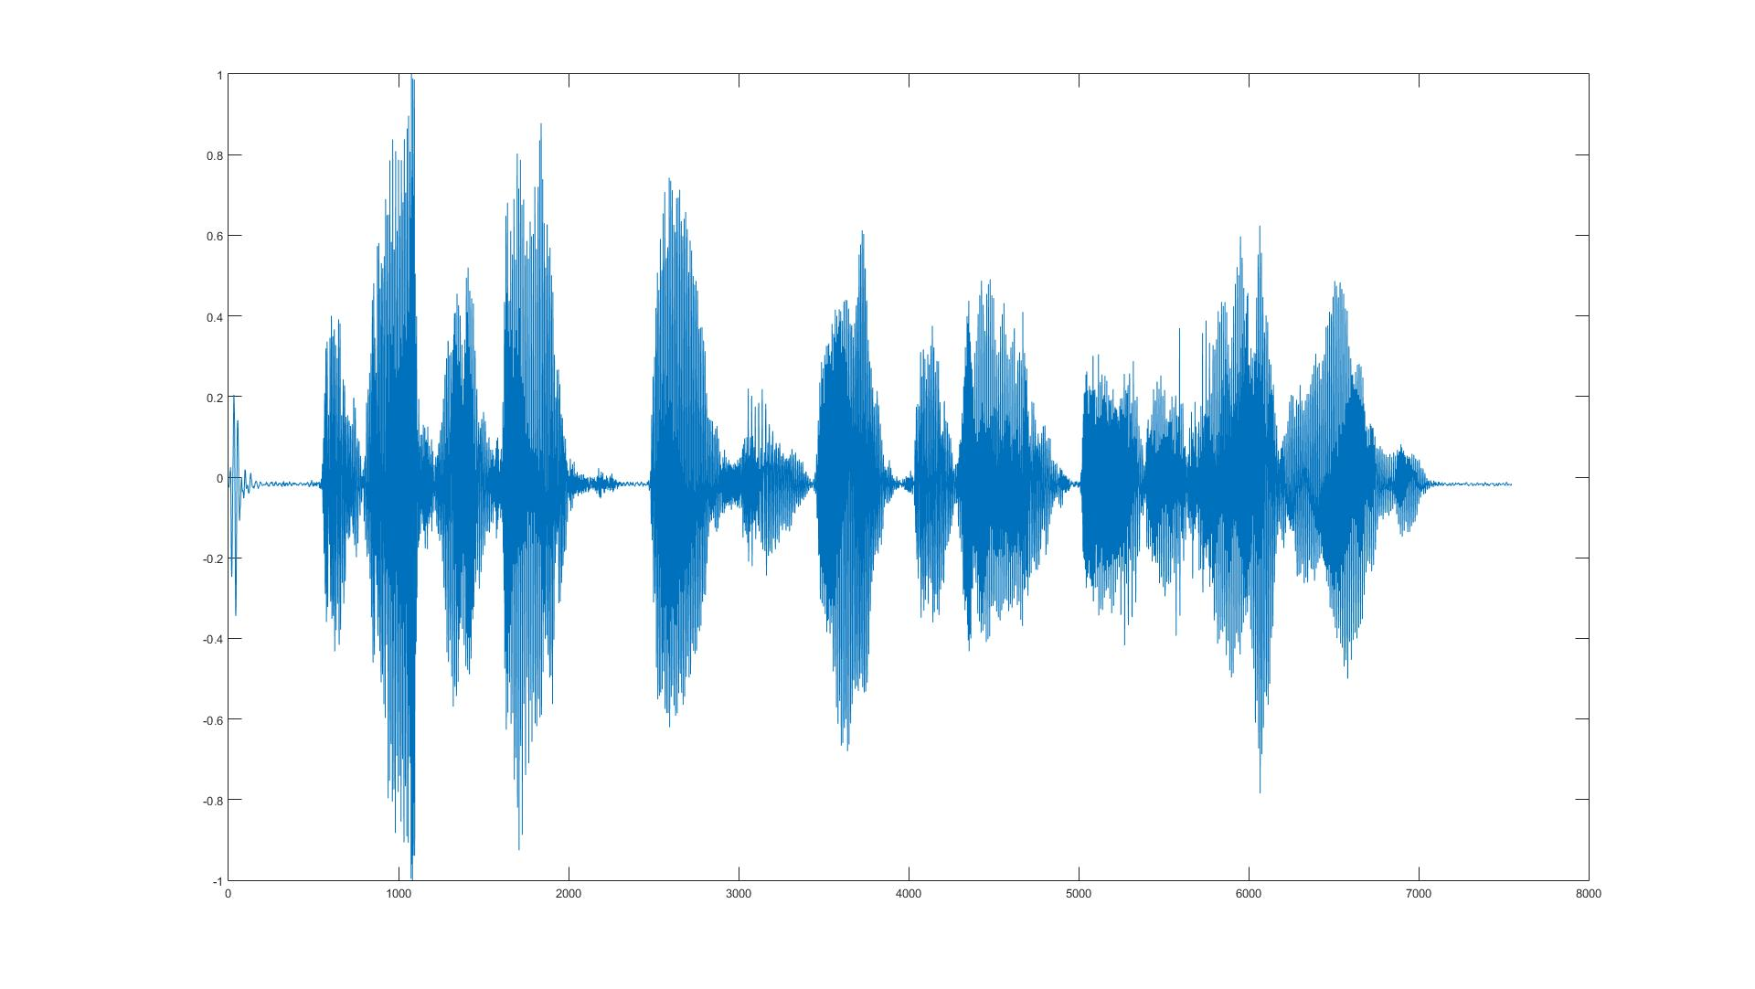

Slide 3



There are 3 primary application domains of speaker diarization
Conversation
Broadcast News
Meeting

Slide 4
Speaker diarization consists of speaker segmentation and clustering
Segmentation: Identify speaker change point

Slide 5


Speaker diarization consists of speaker segmentation and clustering
Clustering: agglomerate segments
into groups that from the same speaker

